Slide 1
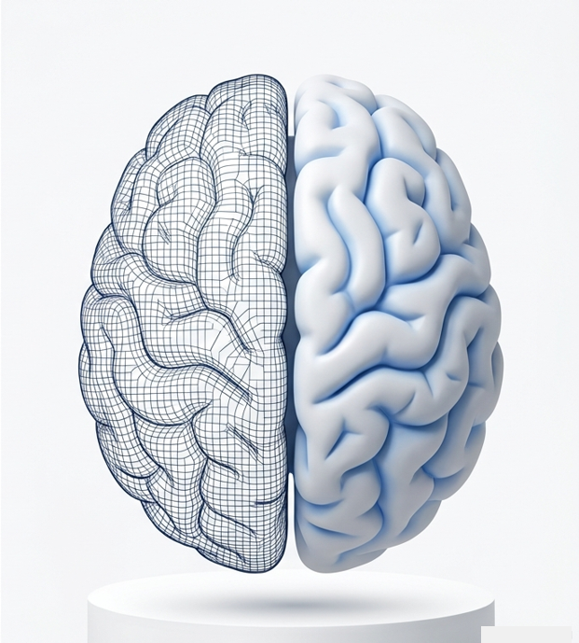
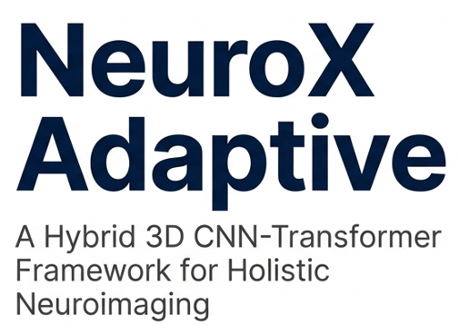
Team Members:
Sandireddy Manideep (22BCE1434)
Munta Sai Karthik (22BCE5060)
Gotam Sai Varshith (22BCE1605)
Guide Name:
Dr. Jayaram B

Slide 2
Introduction
Current Diagnostic Bottleneck: Modern medical imaging, such as MRI and CT, produces massive 3D volumetric datasets (NIfTI) that require exhaustive manual review by radiologists, leading to potential diagnostic fatigue and delays.
The Problem of "Siloed" AI: Existing Computer-Aided Diagnosis (CAD) tools are typically task-specific, meaning a clinician must run separate models for tumor detection, stroke analysis, and neurodegeneration (Alzheimer’s).
The Need for Volumetric Context: Standard 2D slice-by-slice analysis often fails to capture the global structural symmetry and long-range anatomical relationships necessary for early-stage pathology detection.

Slide 3
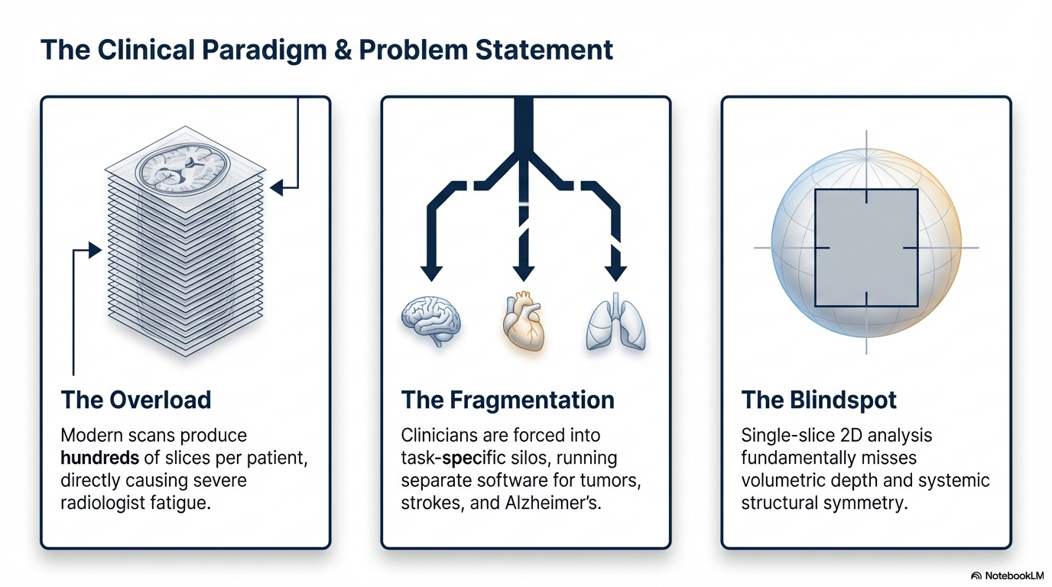

Slide 4
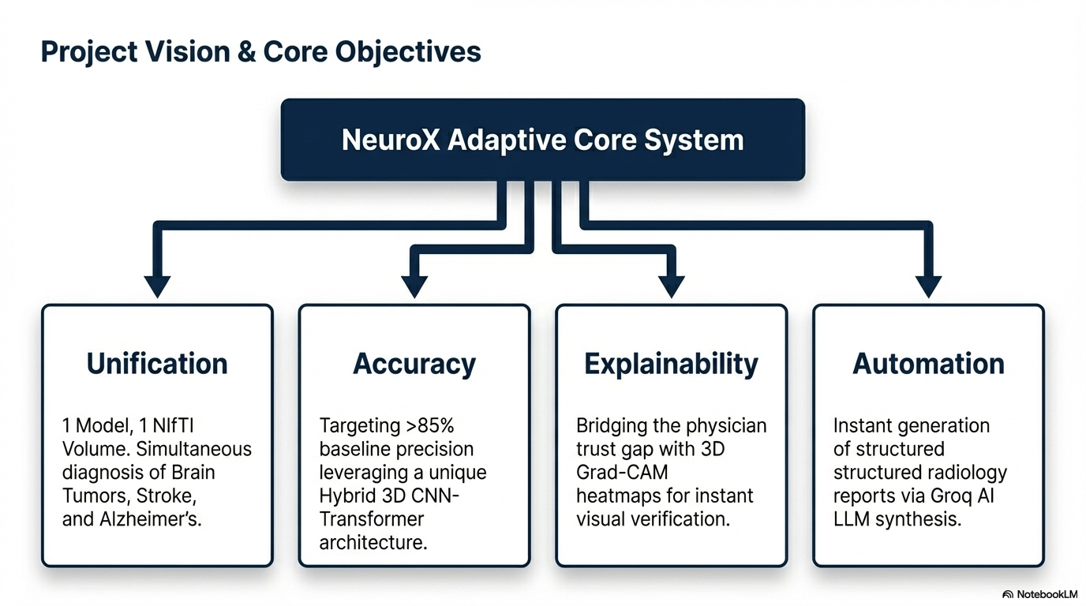

Slide 5
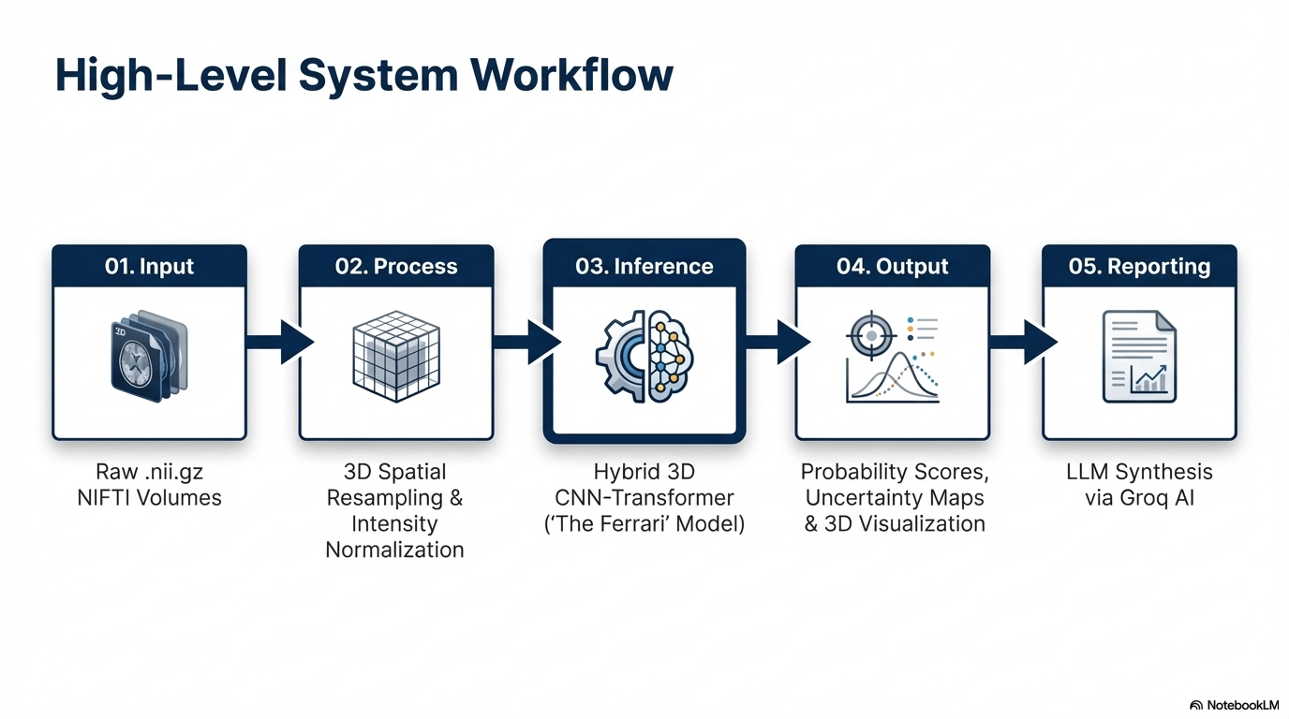

Slide 6
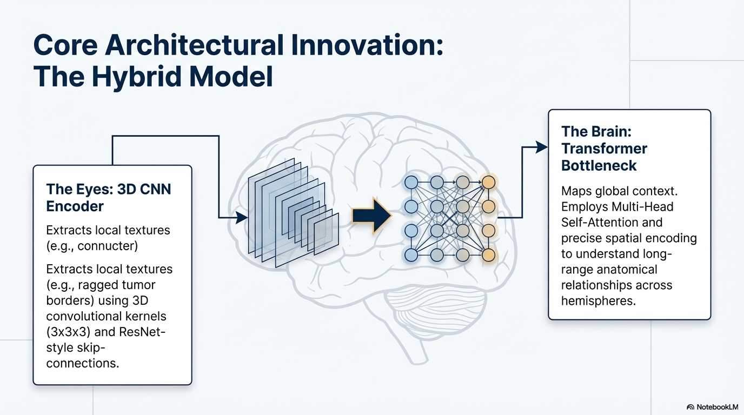

Slide 7
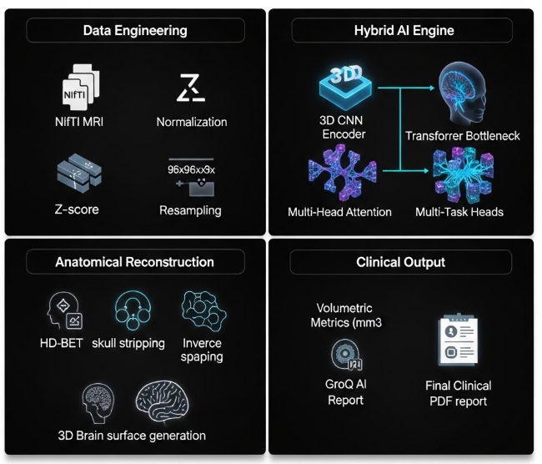
NeuroX Adaptive: Global Functional Architecture

Slide 8
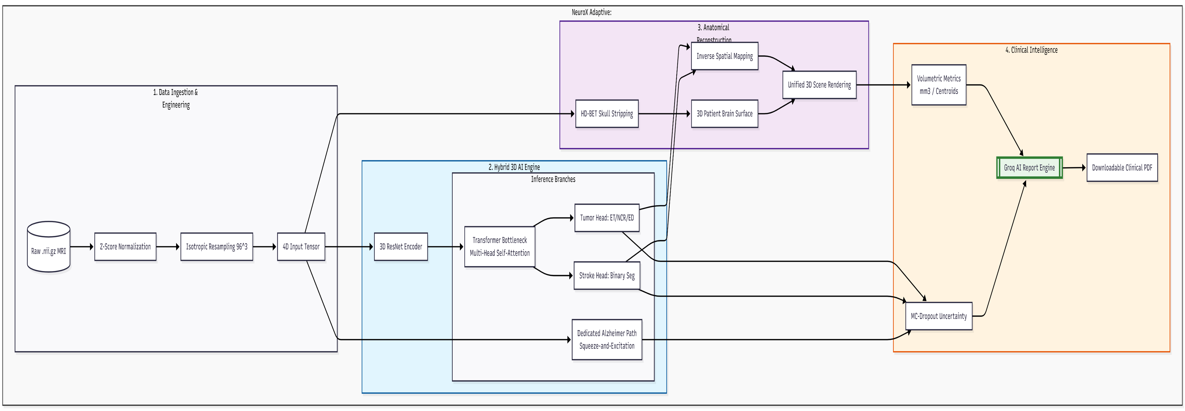
NeuroX Adaptive: Architecture Diagram

Slide 9
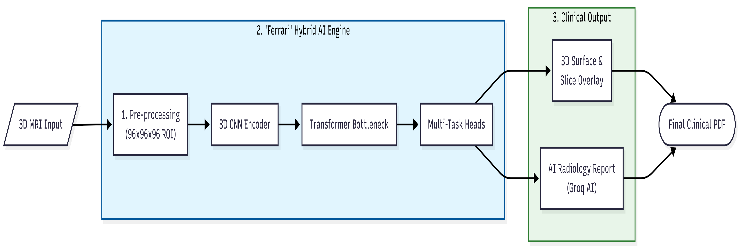
NeuroX Adaptive: Flow Chat

Slide 10
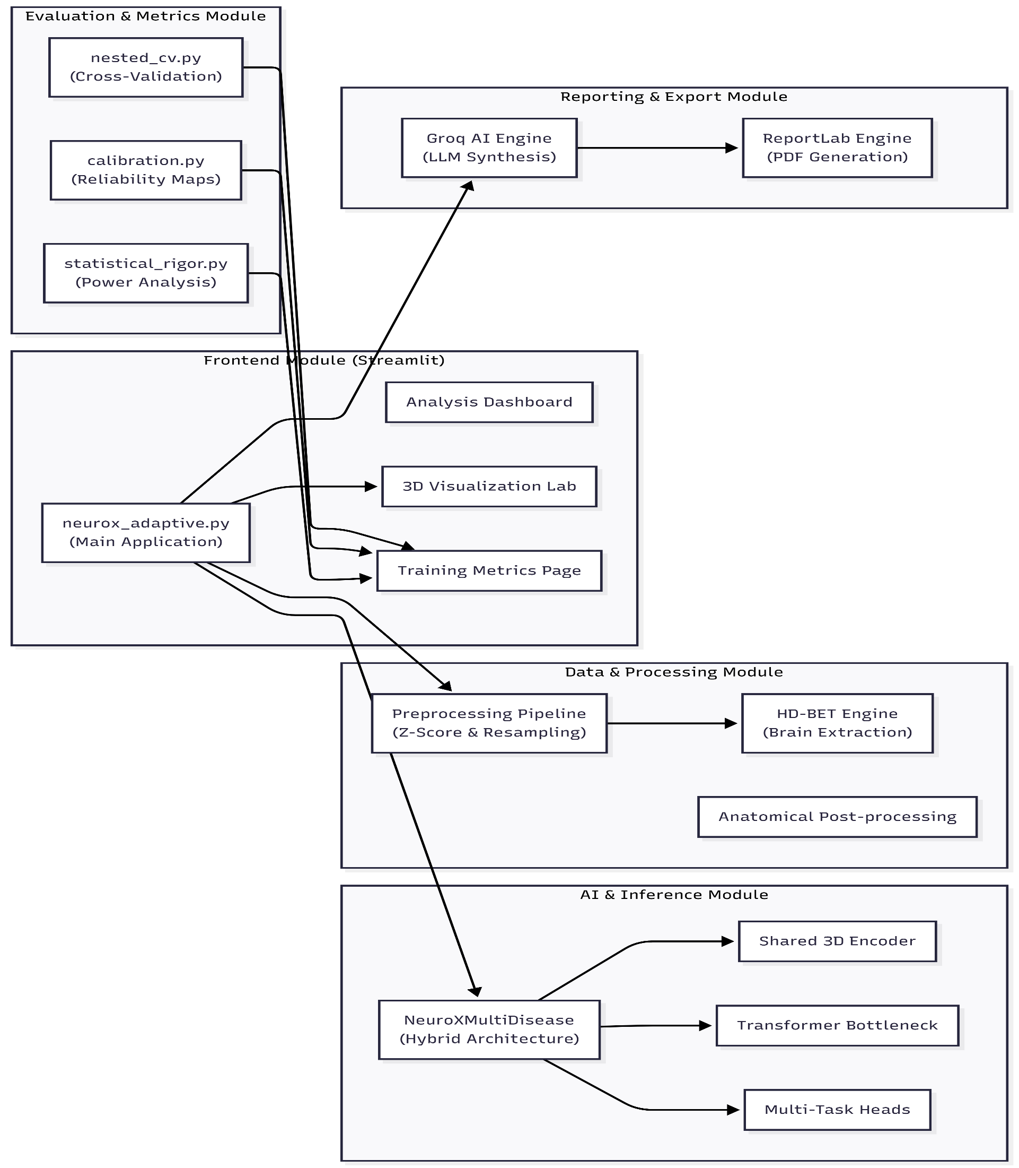
NeuroX Adaptive: Modal Diagram

Slide 11
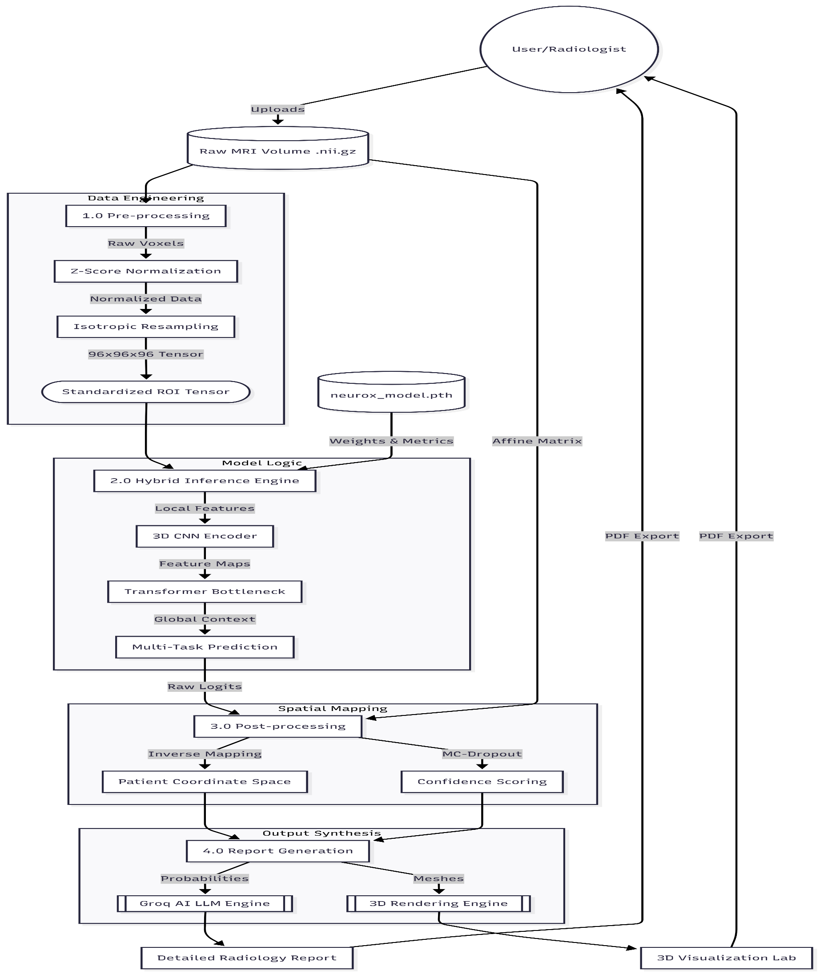
NeuroX Adaptive: Data Flow Diagram

Slide 12
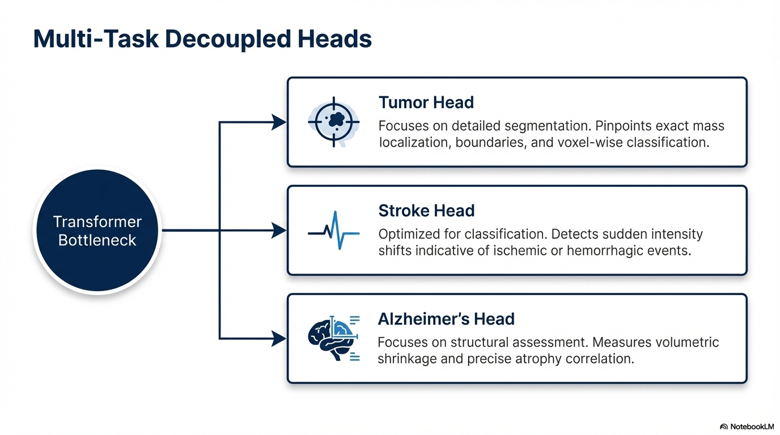

Slide 13
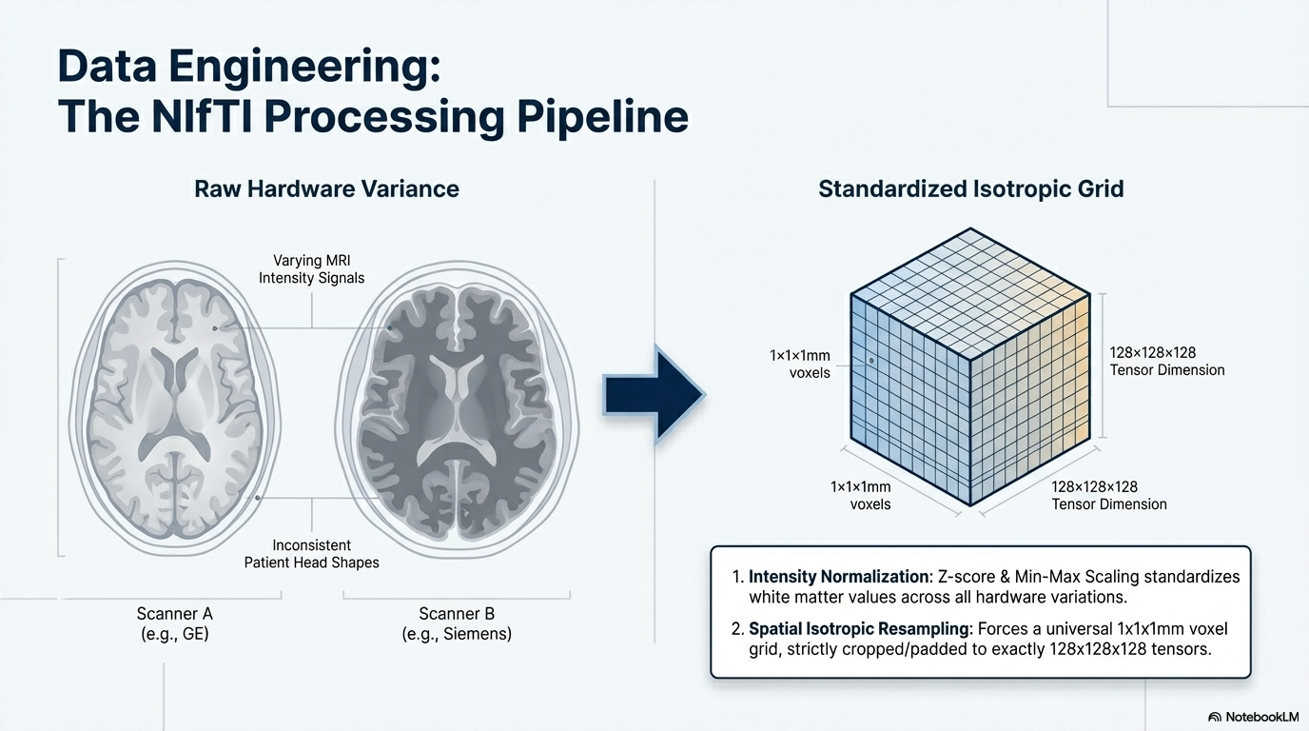

Slide 14
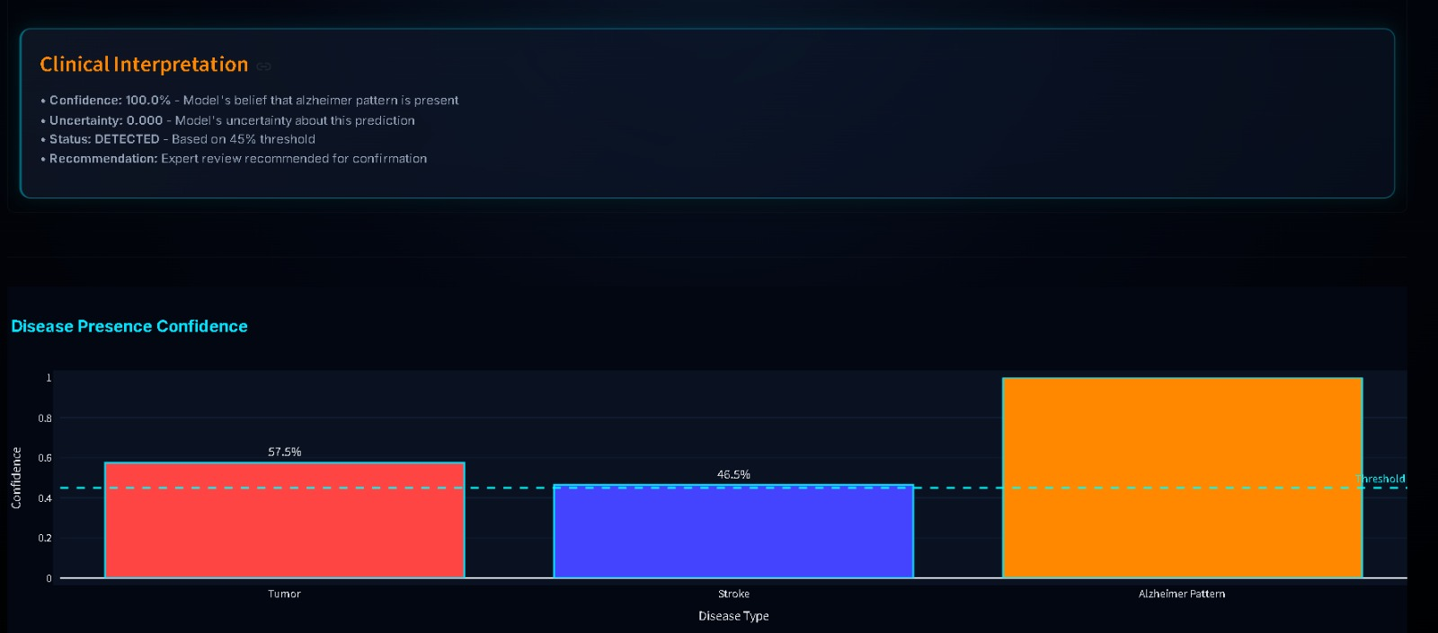
Result:

Slide 15
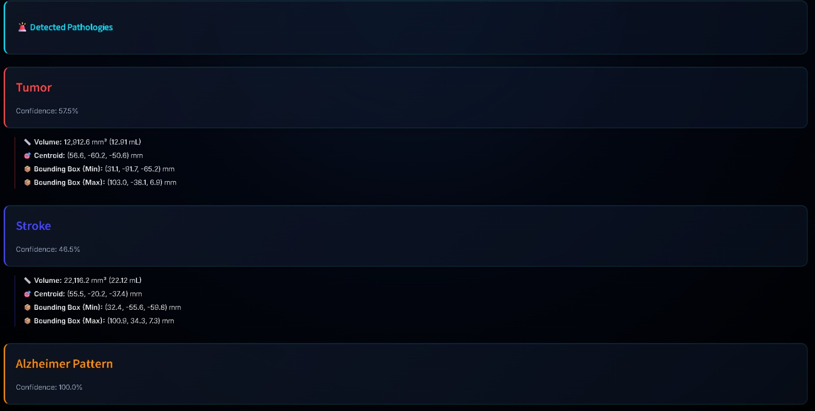
Result:

Slide 16
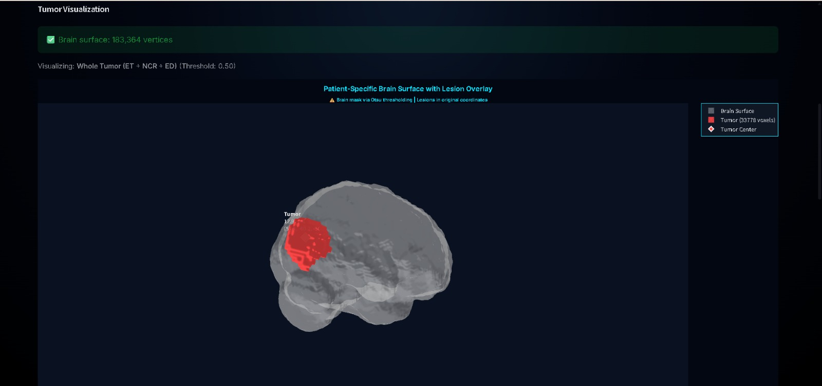
Result:

Slide 17
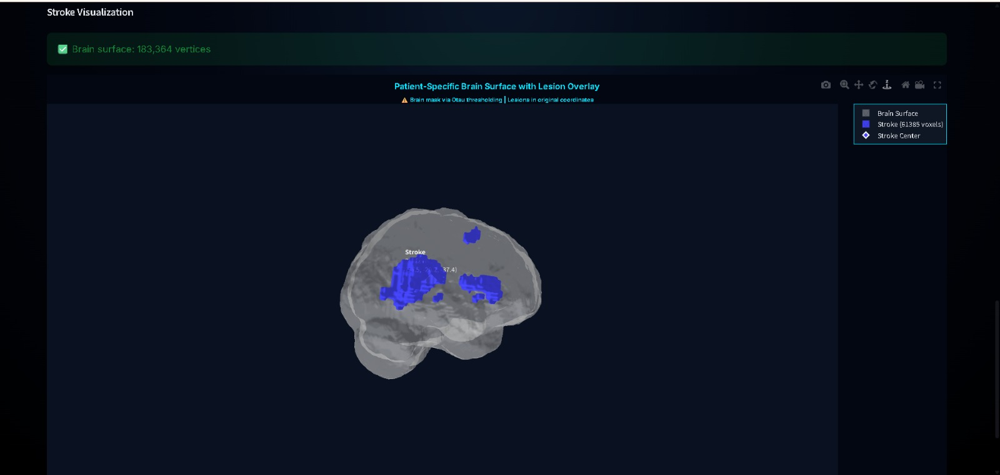
Result:

Slide 18
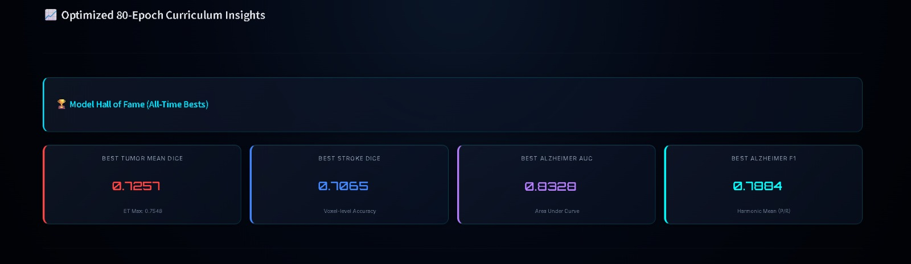
Result:

Slide 19
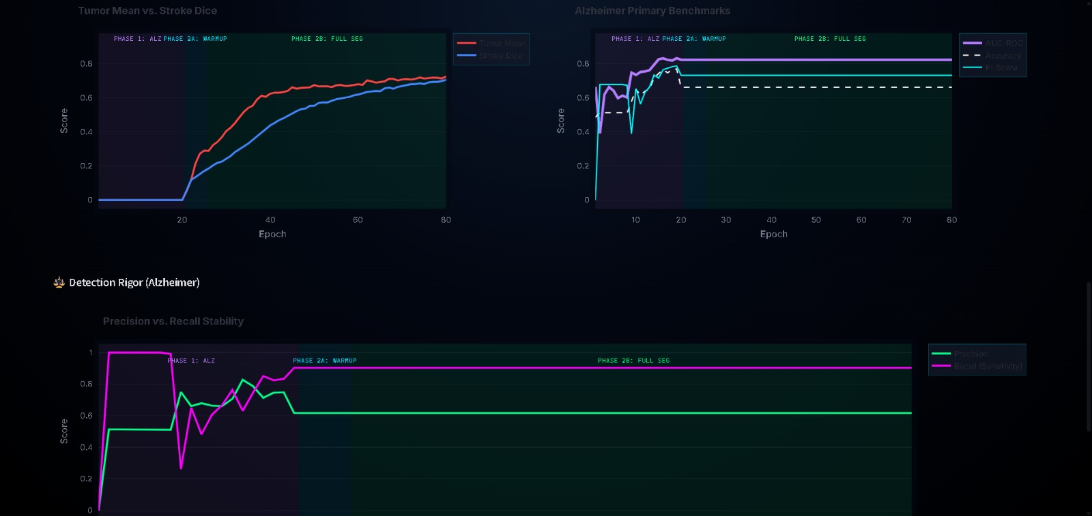
Result:

Slide 20
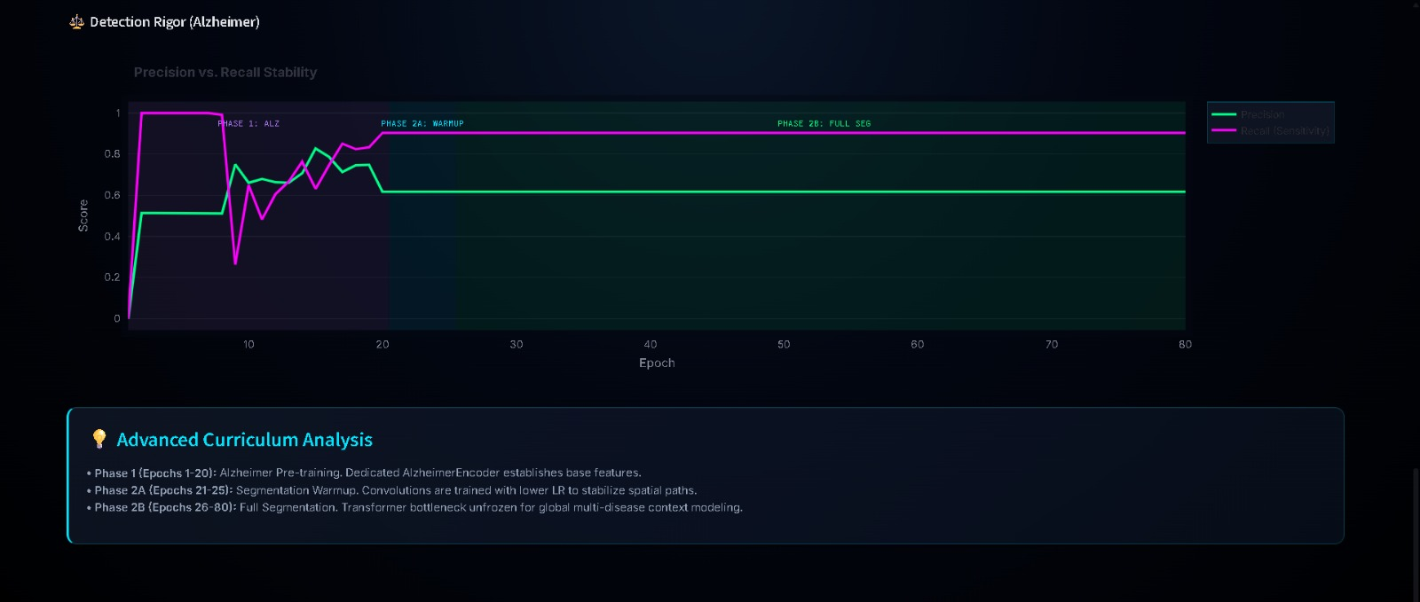
Result:

Slide 21
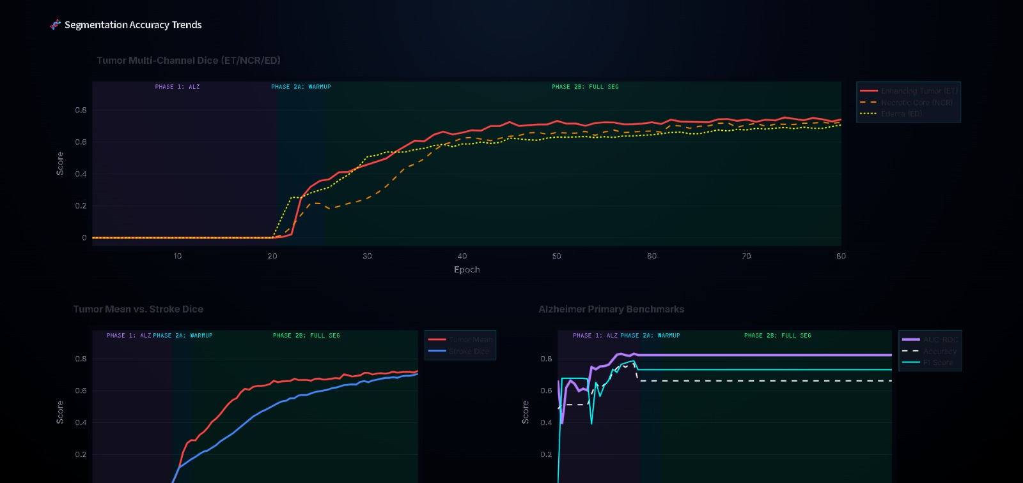
Result:

Slide 22
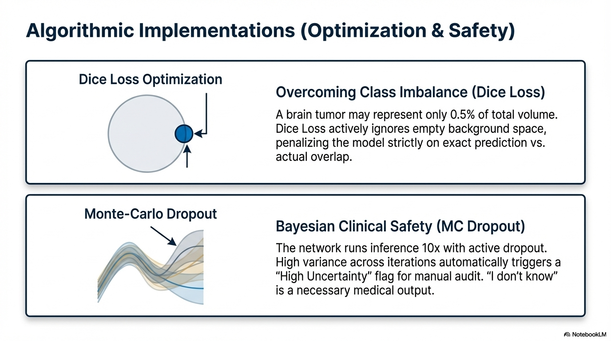

Slide 23
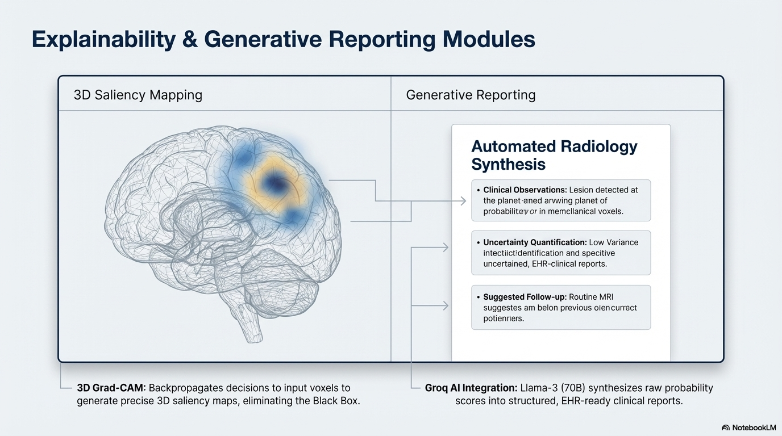

Slide 24
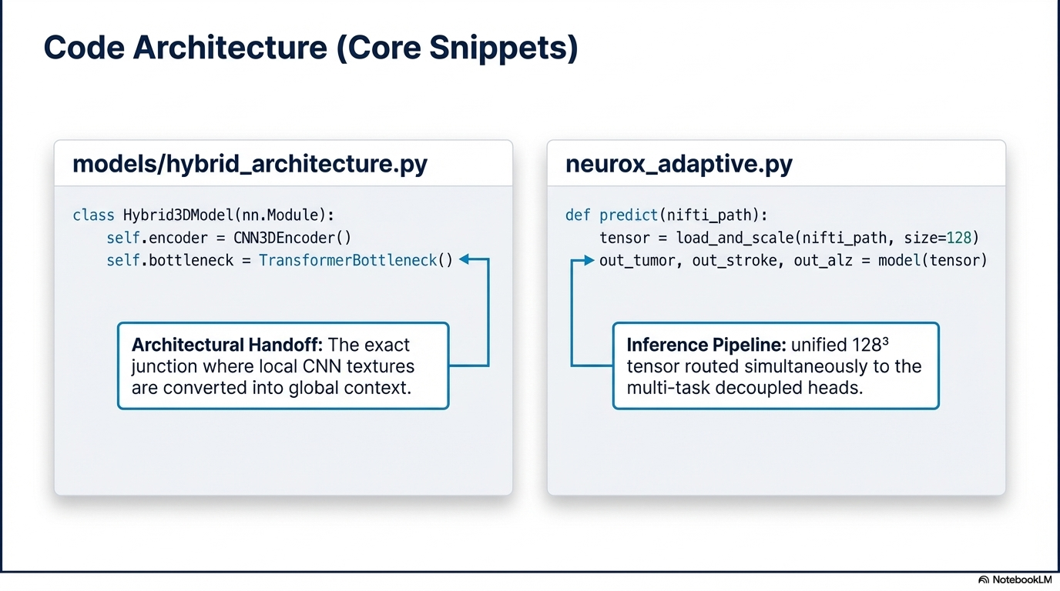

Slide 25
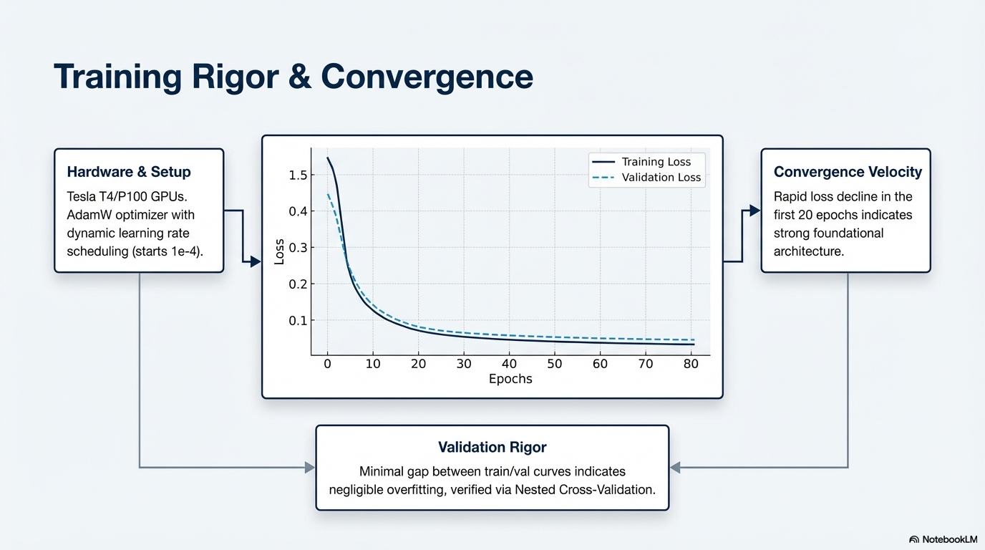

Slide 26
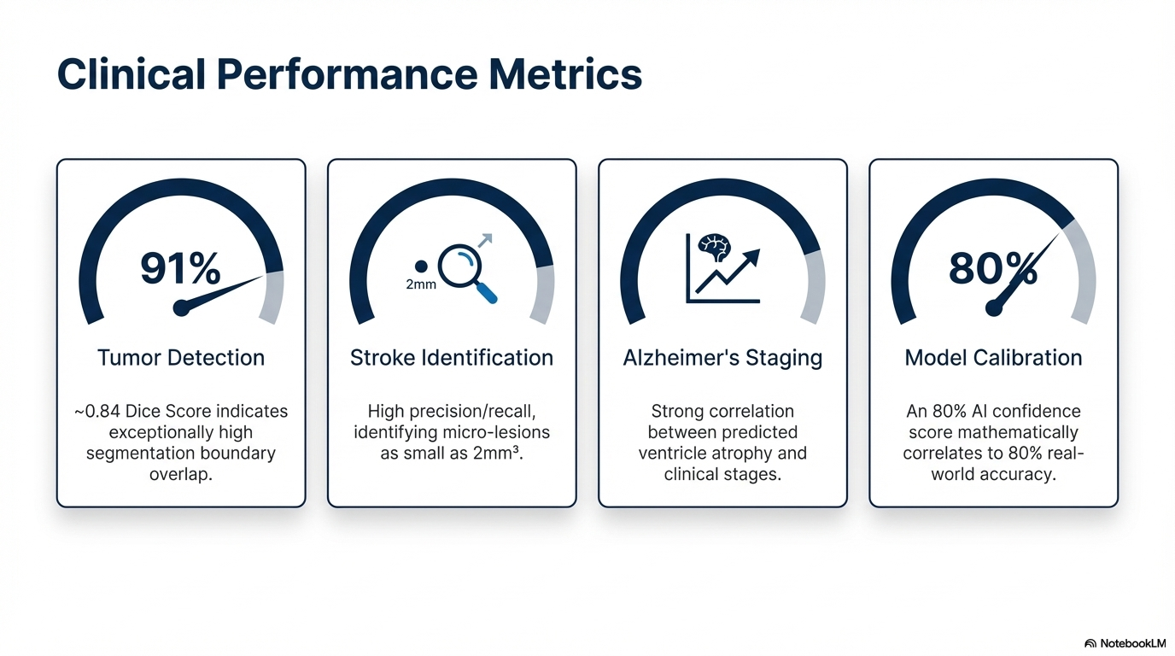

Slide 27
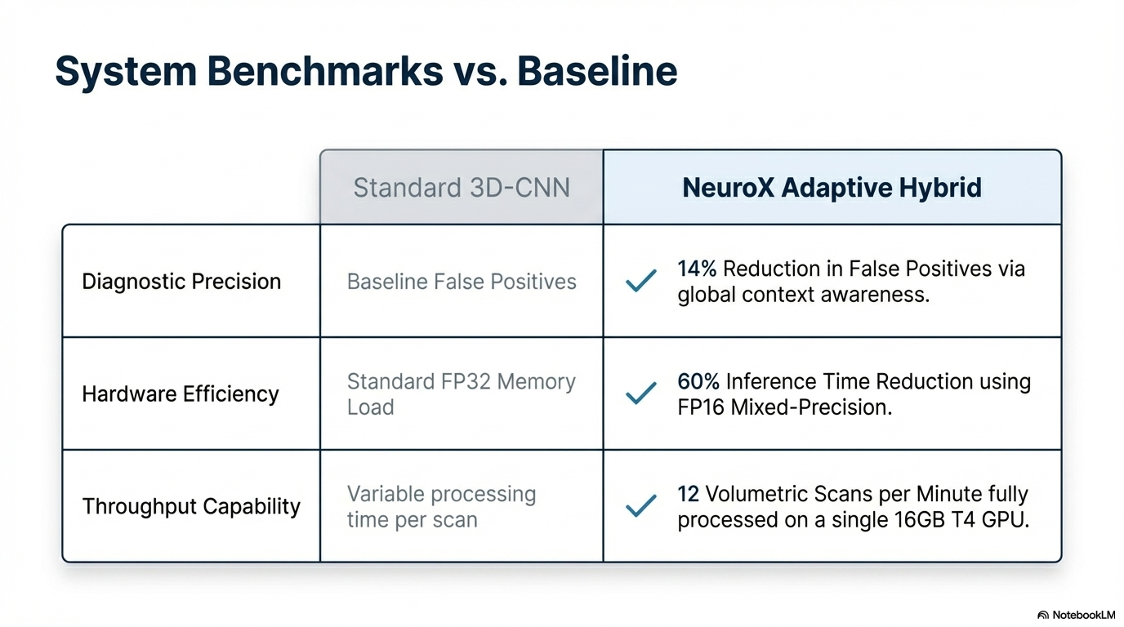

Slide 28
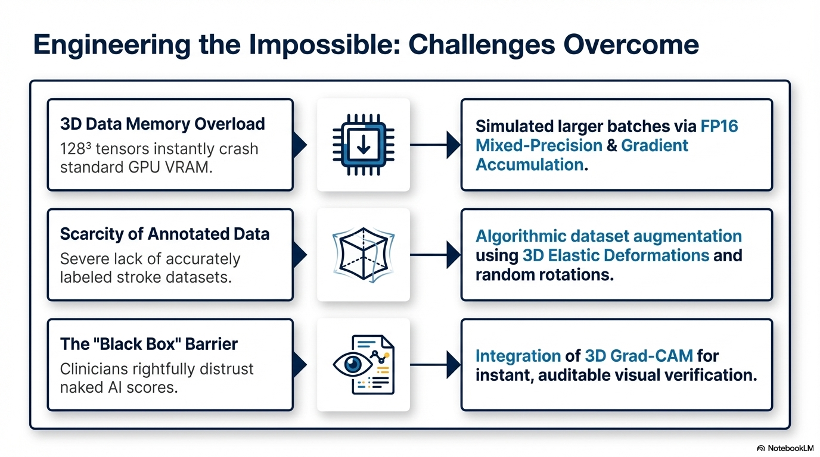

Slide 29
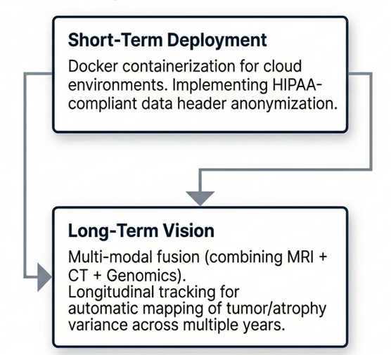
Future Scope:

Slide 30
References:
# | Reference (APA 7th Edition) | Core Relevance to Project
1 | Gal, Y., & Ghahramani, Z. (2016). Dropout as a Bayesian approximation: Representing model uncertainty in deep learning. Proceedings of the 33rd International Conference on Machine Learning, 1050–1059. | The mathematical foundation for the Monte-Carlo Dropout used in your PresenceHead to quantify diagnostic uncertainty.
2 | Isensee, F., et al. (2019). Automated brain extraction of multisequence MRI using artificial neural networks. Human Brain Mapping, 40(17), 4952–4964. | The primary reference for HD-BET, the gold-standard tool your system uses for medical-grade skull stripping.
3 | Vaswani, A., et al. (2017). Attention is all you need. Advances in Neural Information Processing Systems, 5998–6008. | Provides the Transformer Self-Attention logic implemented in your TransformerBottleneck3D for global anatomical context.
4 | Ronneberger, O., Fischer, P., & Brox, T. (2015). U-Net: Convolutional networks for biomedical image segmentation. MICCAI 2015, 234–241. | The foundational architecture for your SegmentationDecoder, which identifies tumor and stroke boundaries.
5 | Hu, J., Shen, L., & Sun, G. (2018). Squeeze-and-excitation networks. Proceedings of the IEEE Conference on Computer Vision and Pattern Recognition, 7132–7141. | Basis for the SEBlock in your AlzheimerEncoder that helps focus the model on relevant channel features.

Slide 31
References:
# | Reference (APA 7th Edition) | Core Relevance to Project
6 | Guo, C., et al. (2017). On calibration of modern neural networks. Proceedings of the 34th International Conference on Machine Learning, 1321–1330. | Justifies the use of Calibration Curves to ensure your model's confidence scores match clinical reality.
7 | Sechidis, K., Tsoumakas, G., & Vlahavas, I. (2011). On the stratification of multi-label data. Machine Learning and Knowledge Discovery in Databases, 145–158. | Supports the Multi-Label approach where one patient can be diagnosed with multiple diseases simultaneously.
8 | Vickers, A. J., & Elkin, E. B. (2006). Decision curve analysis: A novel method for evaluating prediction models. Medical Decision Making, 26(6), 565–574. | The standard for the Decision Curve Analysis found in your statistical_rigor.py evaluation module.
9 | Varma, S., & Simon, R. (2006). Bias in error estimation when using cross-validation for model selection. BMC Bioinformatics, 7(1), 1–8. | Provides the methodology for the Nested Cross-Validation (5x2) used to validate your model's performance.
10 | Lin, T. Y., et al. (2017). Focal loss for dense object detection. Proceedings of the IEEE International Conference on Computer Vision, 2980–2988. | Supports the loss optimization strategies used to handle the class imbalance of small brain lesions.

